Slide 1
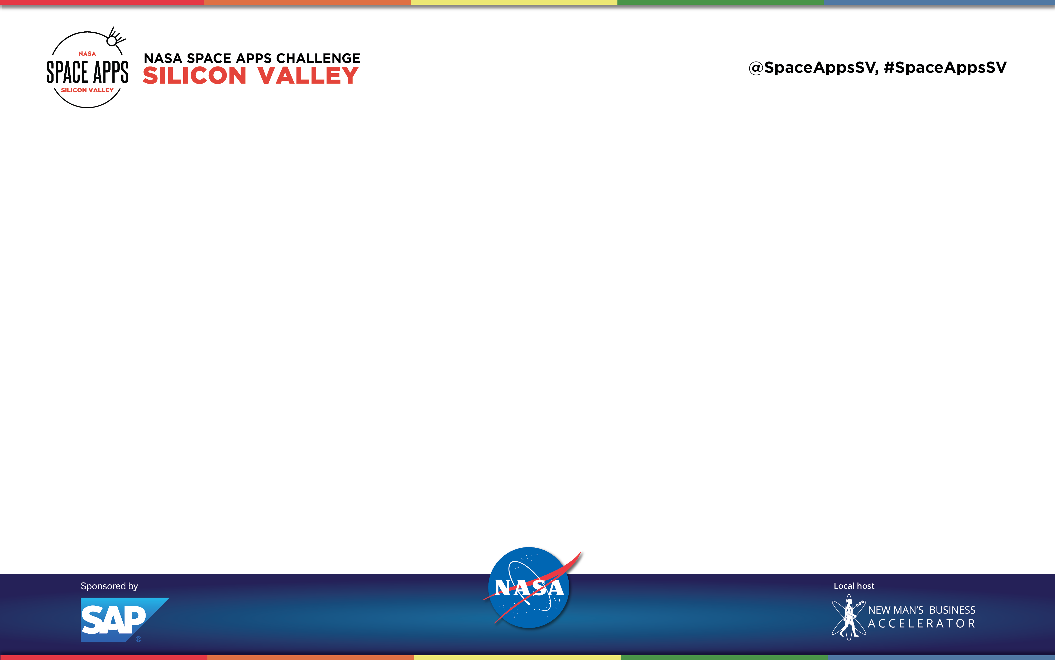
Earth Care
By Dr. Lee’s Lab
Pascal, Jaeyoon, Yuepei, Wendy, Judith, Yao

Slide 2
Do you know how many natural hazards happened on Earth within the past 2 weeks?
Over 20!!

Slide 3
Change global
Notes:
Social impact
Because of that, we have this solution
Solution overview
Team structure & skillset – how we fit with the challenge
This project can help XX people on earth

Slide 4
Real time coverage of natural hazards world wide
Notes:
Cover as many Considerations of the challenge
Challenge:
Examine current natural events curated by NASA’s EONET (Earth Observatory Natural Event Tracker) by browsing global historical and near real-time imagery from space.
Solution:
A platform to provide first hand coverage of all the natural hazards happen on earth
Address the points from the solve
Make the points of these
Change the global’s mindset towards natural hazards

Slide 5
Communicate about our changing planet using big data
Notes:
Cover as many Considerations of the challenge
Challenge:
Use NASA Earth observations data, social media, smart phones, and Short Message Service (SMS) text phones to collect Earth observations and connect public in local, regional, and national networks to communicate about our changing planet.
Solution:
- Intergrade all source of data to illustrate the historical & current social impact of the natural hazards
Address the points from the solve
Make the points of these
Change the global’s mindset towards natural hazards

Slide 6
Make positive social impact by sharing information and personal experience
Notes:
Cover as many Considerations of the challenge
Challenge:
Upload images or other data points demonstrating visible observations and how they compare to satellite data. For example, generating early-warning alerts or validating precipitation rates reported from NASA’s Global Precipitation Measurement Mission.
Solution:
Provide the channel for people to share their personal experience regarding certain natural hazards
Address the points from the solve
Make the points of these
Change the global’s mindset towards natural hazards

Slide 7
DEMO

Slide 8
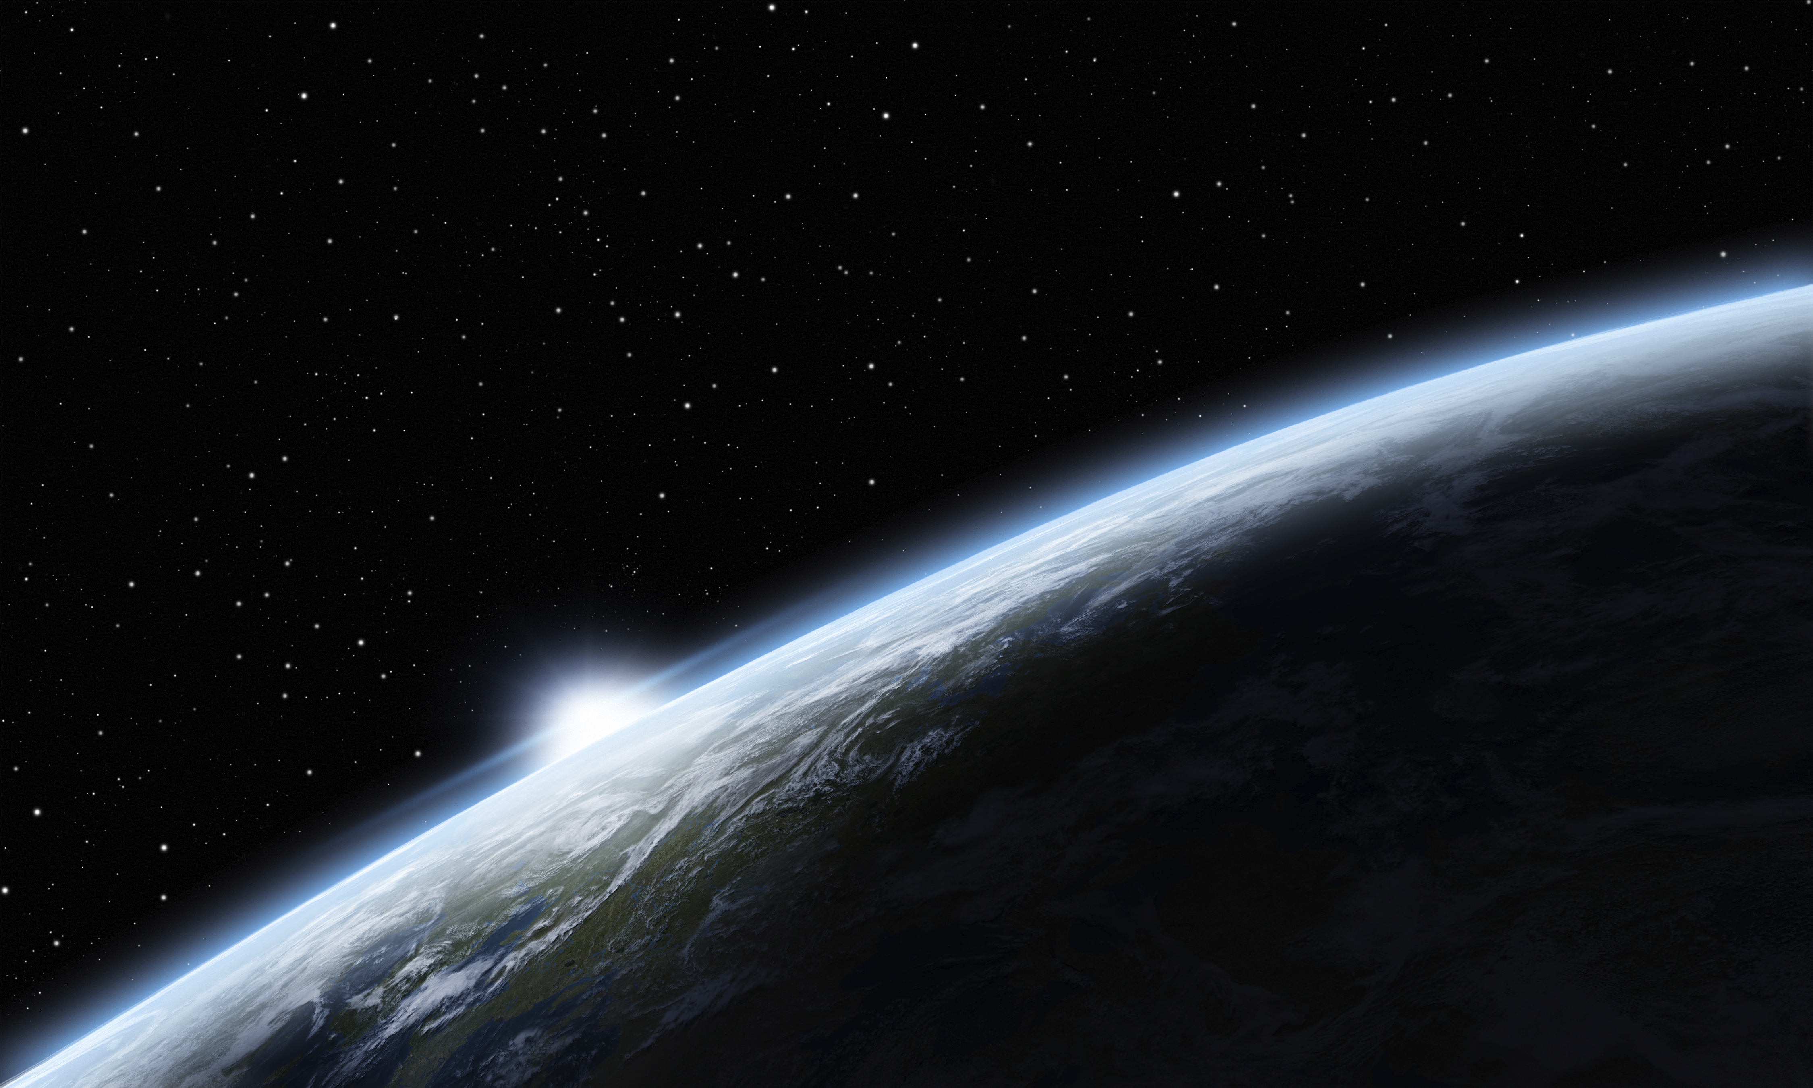
Earth Care for a better world
Earth Care

